Slide 1
Data Augmentation
Pravin Y Pawar
Adapted from Designing Machine Learning Systems
by Chip Huyen

Slide 2
Data Augmentation
A family of techniques that are used to increase the amount of training data
Traditionally, used for tasks that have limited training data, such as in medical imaging projects
However, in the last few years, shown to be useful even when have a lot of data
because augmented data can make models more robust to noise and even adversarial attacks
Data augmentation has
become a standard step in many computer vision tasks
finding its way into natural language processing (NLP) tasks
Three main types of data augmentation:
simple label-preserving transformations,
perturbation, which is a term for “adding noises”,
data synthesis

Slide 3
Simple Label-Preserving Transformations
Computer vision
In computer vision, the simplest data augmentation technique is to randomly modify an image while preserving its label
can modify the image by
cropping,
flipping,
rotating,
inverting (horizontally or vertically),
erasing part of the image, and more
makes sense because a rotated image of a dog is still a dog
Common ML frameworks like PyTorch and Keras both have support for image augmentation
According to Krizhevsky et al., in their legendary AlexNet paper,
“the transformed images are generated in Python code on the CPU while the GPU is training on the previous batch of images. So these data augmentation schemes are, in effect, computationally free.”

Slide 4
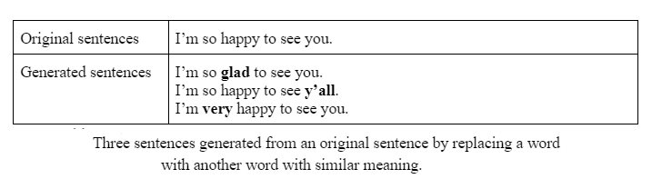
Simple Label-Preserving Transformations
NLP
In NLP, can randomly replace a word with a similar word,
assuming that this replacement wouldn’t change the meaning or the sentiment of the sentence
Similar words can be found
either with a dictionary of synonymous words,
or by finding words whose embedding's are close to each other in a word embedding space
This type of data augmentation is a quick way to double, even triple training data

Slide 5
Perturbation
Perturbation is also a label-preserving operation,
but sometimes, used to trick models into making wrong predictions
Neural networks, in general, are sensitive to noise.
In the case of computer vision, this means that by adding a small amount of noise to an image can
cause a neural network to misclassify it.
Adversarial attacks
Using deceptive data to trick a neural network into making wrong predictions
Adding noise to samples to create adversarial samples is a common technique
Success of adversarial attacks is especially exaggerated as the resolution of images increases

Slide 6
Perturbation
Aadversarial augmentation
Adding noisy samples to training data can help models recognize the weak spots in their learned decision boundary and improve their performance
Noisy samples can be created by either adding random noise or by a search strategy
Moosavi-Dezfooli et al. proposed an algorithm, called DeepFool, that finds the minimum possible noise injection needed to cause a misclassification with high confidence
Adversarial augmentation is less common in NLP but perturbation has been used to make models more robust
One of the most notable examples is BERT

Slide 7
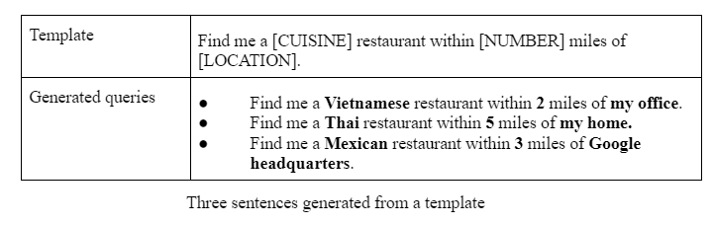
Data Synthesis
Since collecting data is expensive and slow with many potential privacy concerns
it’d be a dream if could sidestep it altogether and train models with synthesized data
Still far from being able to synthesize all training data,
it’s possible to synthesize some training data to boost a model’s performance
In NLP,
templates can be a cheap way to bootstrap model.
A template might look like:
“Find me a [CUISINE] restaurant within [NUMBER] miles of [LOCATION].” With lists of all possible cuisines, reasonable numbers (you would probably never want to search for restaurants beyond 1000 miles), and locations (home, office, landmarks, exact addresses) for each city, you can generate thousands of training queries from a template.

Slide 8
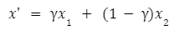
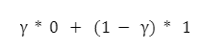
Data Synthesis
Computer vision
In computer vision, a straightforward way to synthesize new data
is to combine existing examples with discrete labels to generate continuous labels
Mixup
Consider a task of classifying images with two possible labels: DOG (encoded as 0) and CAT (encoded as 1)
From example x1 of label DOG and example x2 of label CAT, can generate x' such as:
The label of x' is a combination of the labels of x1and x2:
Research showed mixup
improves models’ generalization
reduces their memorization of corrupt labels
increases their robustness to adversarial examples
and stabilizes the training of generative adversarial networks
Using neural networks to synthesize training data is an exciting approach
actively being researched but not yet popular in production

Slide 9
Thank You!
In our next session:

